Slide 1
CS1020 Lecture Note #3: Object Oriented Programming (OOP) Part 1 – User Mode
A paradigm shift:
From procedural to object-oriented model

Slide 2
Objectives
Java
(Re)introducing API
Basic features/concepts of OOP
Using Java classes

Slide 3
References
Textbook
Chapter 2: Section 2.2 (pg 119 – 130), Section 2.3 (pg 131 – 150)
CS1020 website → Resources → Lectures
http://www.comp.nus.edu.sg/ ~cs1020/2_resources/lectures.html
String class: Section 1.5 (pg 59 – 64)
Wrapper classes: Section 1.1 (pg 29 – 30)
[CS1020 Lecture : OOP Part 1]

Slide 4
Outline (1/2)
Recapitulation
API: Where you find service classes
2.1 Scanner class (revisit)
2.2 String class (revisit)
2.3 Math class (revisit)
OOP concepts (basic)
3.1 Modifiers
3.2 Class vs Instance methods
3.3 Constructors
3.4 Overloading
[CS1020 Lecture : OOP Part 1]

Slide 5
Outline (2/2)
More classes (new)
4.1 DecimalFormat class
4.2 Random class
4.3 Wrapper classes
4.4 Point class
Abstraction and Information Hiding
5.1 What is Abstraction?
5.2 Procedural Abstraction
[CS1020 Lecture : OOP Part 1]

Slide 6
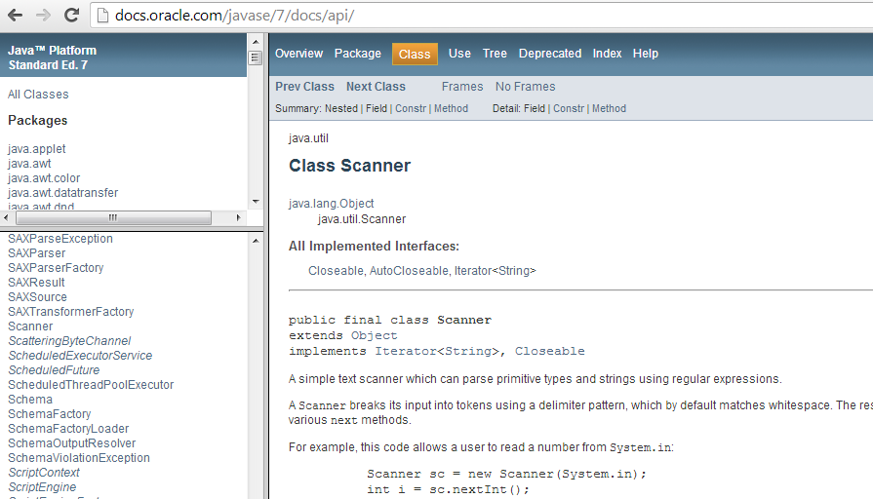
1. Recapitulation
Compiling and running Java programs
Java program structure
Basic Java elements
API: Scanner class, Math class
vim HelloWorld.java
HelloWorld.java
javac HelloWorld.java
HelloWorld.class
java HelloWorld
output
[CS1020 Lecture : OOP Part 1]

Slide 7

2. API (Revisit)
Application Programming Interface – Where you find service classes

Slide 8


Java Programmer
2. API
API Specification
http://docs.oracle.com/javase/7/docs/api/
Last week:
Scanner class
String class
Math class
And from now on, many many more…
[CS1020 Lecture : OOP Part 1]

Slide 9
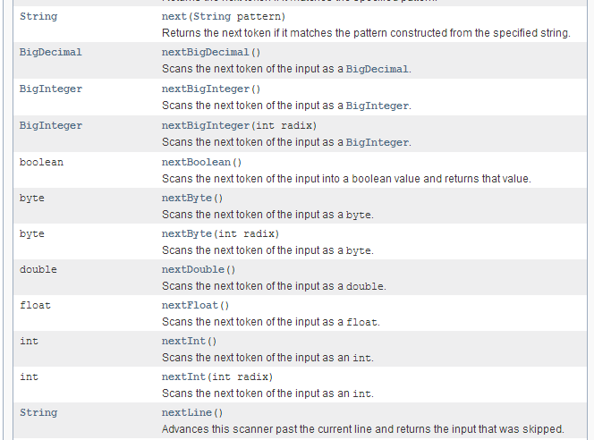
Scanner Class: Reading Inputs
2. API
API documentation
http://docs.oracle.com/javase/7/docs/api/java/util/Scanner.html
For reading input
Import java.util.Scanner
Note Java naming convention
Method names – lowerCamelCase
next()
nextDouble()
nextInt()
nextLine()
…
hasNext()
hasNextDouble()
hasNextInt()
hasNextLine()
…
[CS1020 Lecture : OOP Part 1]

Slide 10
Scanner Class: Demo (1/2)
2. API
Enter name1: Wilson Wee
name1 entered is
Enter name2: Wilson Wee
name2 entered is
???
import java.util.*;
public class TestScanner {
public static void main(String[] args) {
Scanner sc = new Scanner(System.in);
// Comparing nextLine() and next()
System.out.print("Enter name1: ");
String name1 = sc.nextLine();
System.out.println("name1 entered is '" + name1 + "'.");
System.out.print("Enter name2: ");
String name2 = sc.next();
System.out.println("name2 entered is '" + name2 + "'.");
???
TestScanner.java

[CS1020 Lecture : OOP Part 1]

Slide 11
Scanner Class: Demo (2/2)
2. API
sc.nextLine(); // to skip the rest of the line after
// the next() method captured the
// first word of the second name
// Using nextInt() and hasNextInt()
int num, sum = 0;
System.out.println("Enter integers, terminate with control-d:");
while (sc.hasNextInt()) {
num = sc.nextInt();
System.out.println("Integer read: " + num);
sum += num;
}
System.out.println("Sum = " + sum);
}
}
Enter integers, ...
17
Integer read: 17
5
Integer read: 5
(More will be shown in lecture)
What is this for?
Attend lecture for explanation!

[CS1020 Lecture : OOP Part 1]

Slide 12

Scanner Class: For CodeCrunch
2. API
For a program to work in CodeCrunch, it must not have more than one Scanner object with System.in as input stream.
[CS1020 Lecture : OOP Part 1]

Slide 13
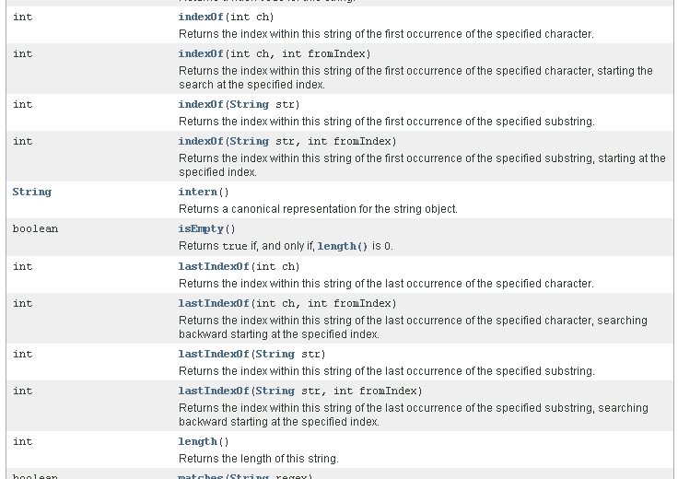
String Class: Representation in Text
2. API
API documentation
http://docs.oracle.com/javase/7/docs/api/java/lang/String.html
Import java.lang.String (optional)
Ubiquitous; Has a rich set of methods
charAt()
concat()
equals()
indexOf()
lastIndexOf()
length()
toLowerCase()
toUpperCase()
substring()
trim()
And many more…
[CS1020 Lecture : OOP Part 1]

Slide 14
String Class: Demo (1/2)
2. API
TestString.java
public class TestString {
public static void main(String[] args) {
String text = new String("I'm studying CS1020.");
// or String text = "I'm studying CS1020.";
// We will explain the difference later.
System.out.println("text: " + text);
System.out.println("text.length() = " + text.length());
System.out.println("text.charAt(5) = " + text.charAt(5));
System.out.println("text.substring(5,8) = " +
text.substring(5,8));
System.out.println("text.indexOf(\"in\") = " +
text.indexOf("in"));
String newText = text + "How about you?";
newText = newText.toUpperCase();
System.out.println("newText: " + newText);
if (text.equals(newText))
System.out.println("text and newText are equal.");
else
System.out.println("text and newText are not equal.");
}
}
[CS1020 Lecture : OOP Part 1]

Slide 15
String Class: Demo (2/2)
2. API
Outputs
Explanations
text: I'm studying CS1020.
length() returns the length (number of characters) in text
text.length() = 20
text.charAt(5) = t
charAt(5) returns the character at position 5 in text
text.substring(5,8) = tud
substring(5,8) returns the substring in text from position 5 (‘t’) through position 7 (‘d’). ← Take note
text.indexOf("in") = 9
indexOf("in") returns the …?
newText = newText.toUppercase()
converts characters in newText to uppercase.
The + operator is string concatenation.
newText: I'M STUDYING CS1020.HOW ABOUT YOU?
equals() compares two String objects. Do not use ==. (To be explained later.)
text and newText are not equal.

[CS1020 Lecture : OOP Part 1]

Slide 16
String Class: Comparing strings
2. API
As strings are objects, do not use == if you want to check if two strings contain the same text
Use the equals() method provided in the String class instead (more details about equals() in next lecture)
Scanner sc = new Scanner(System.in);
System.out.println("Enter 2 identical strings:");
String str1 = sc.nextLine();
String str2 = sc.nextLine();
System.out.println(str1 == str2);
System.out.println(str1.equals(str2));
Enter 2 identical …
Hello world!
Hello world!
(What will be printed?)

[CS1020 Lecture : OOP Part 1]

Slide 17
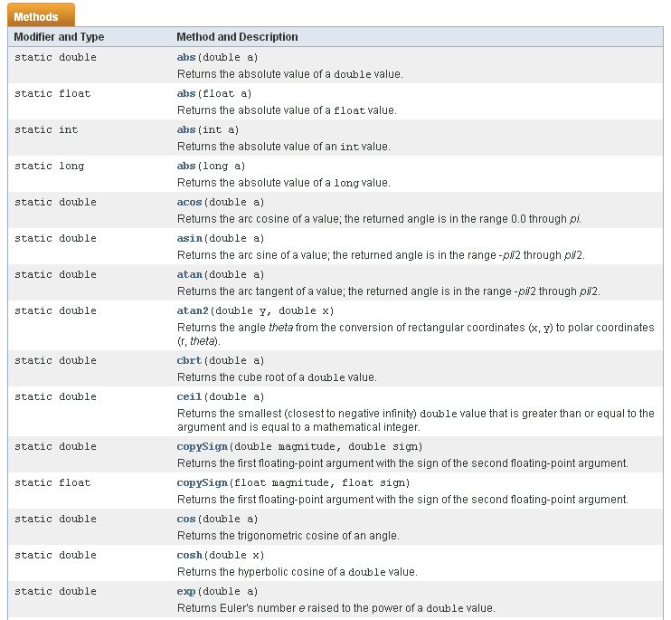
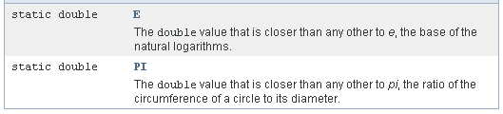
Math Class: Performing Computation
2. API
API documentation
http://docs.oracle.com/javase/7/docs/api/java/lang/Math.html
Import java.lang.String (optional)
abs()
ceil()
floor()
hypot()
max()
min()
pow()
random()
sqrt()
And many more…
2 class attributes (constants):
E and PI
[CS1020 Lecture : OOP Part 1]

Slide 18
Math Class: Demo
2. API
A demo was given last week. Here’s another.
Enter 3 values: 3.2 9.6 5.8
pow(3.20,9.60) = 70703.317
Largest = 9.6
Generating 5 random values:
0.874782725744965
0.948361014412348
0.8968816217113053
0.028525690859603103
0.5846509364262972
import java.util.*;
public class TestMath2 {
public static void main(String[] args) {
Scanner sc = new Scanner(System.in);
System.out.print("Enter 3 values: ");
double num1 = sc.nextDouble();
double num2 = sc.nextDouble();
double num3 = sc.nextDouble();
System.out.printf("pow(%.2f,%.2f) = %.3f\n",
num1, num2, Math.pow(num1,num2));
System.out.println("Largest = " +
Math.max(Math.max(num1,num2), num3));
System.out.println("Generating 5 random values:");
for (int i=0; i<5; i++)
System.out.println(Math.random());
}
}
TestMath2.java
[CS1020 Lecture : OOP Part 1]

Slide 19
Practice Exercises
2. API
Scanner class: Practice Exercises #8 and #9
String class: Practice Exercises #7 and #10
Math class: Practice Exercise #11
Mounted on CodeCrunch and also listed on the CS1020 website → “Practice Exercises” page
http://www.comp.nus.edu.sg/~cs1020/4_misc/practice.html
Attempt these exercises and discuss them on the IVLE forum
[CS1020 Lecture : OOP Part 1]

Slide 20
3. OOP Concepts
What makes Java object-oriented?

Slide 21
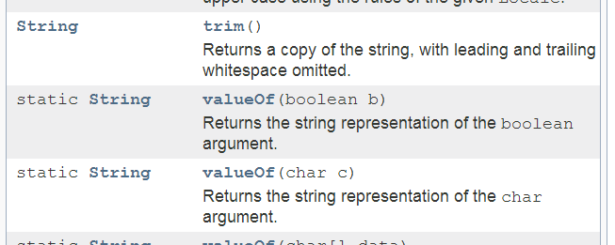
Modifiers
: keywords added to specify the way a class/attribute/method works
3. OOP
public class TestMath2
public static void main(String[] args)
Access-control modifiers: public, private, etc.
Non-access modifiers
More about ‘public’ and ‘private’ in next lecture.
[CS1020 Lecture : OOP Part 1]

Slide 22
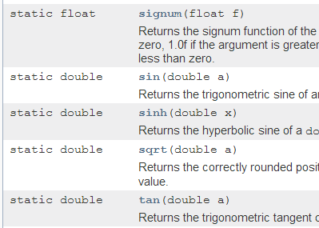
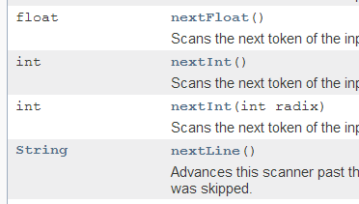
Class vs Instance methods (1/4)
Math class
3. OOP
String class
A static method (preferably called a class method) means that no object (instance) of the class is needed to use the method.
A non-static method (preferably called an instance method) means that the method must be applied to an object (instance) of that class.
Scanner class
[CS1020 Lecture : OOP Part 1]

Slide 23
Class vs Instance methods (2/4)
Math class
3. OOP
String class
Observations
All methods in the Math class are class methods.
All methods in the Scanner class are instance methods.
The String class comprises a mix of class and instance methods.
Scanner class
[CS1020 Lecture : OOP Part 1]

Slide 24
Class vs Instance methods (3/4)
3. OOP
Calling a class method
double answer = Math.pow(3.5, 2.2);
Precede method with the class name
public class Exercise {
public static double volumeCone(double rad, double ht) {
return Math.PI * rad * rad * ht / 3.0;
}
public static void main(String[] args) {
. . .
double vol = volumeCone(radius, height);
/* Alternatively:
double vol = Exercise.volumeCone(radius, height);
*/
}
}
Optional to precede method with the class name if the method is defined in the class it is called.
[CS1020 Lecture : OOP Part 1]

Slide 25


Class vs Instance methods (4/4)
3. OOP
Calling an instance method
int value = Scanner.nextInt();
// create an instance (object) of Scanner
Scanner sc = new Scanner(System.in);
int value = sc.nextInt();
String str = "Some text";
str = String.toUpperCase();
String str = "Some text";
str = str.toUpperCase();
An instance method must be applied to an instance (object) of a class.
“Calling an instance method” is sometimes referred to as “passing a message to an instance (object)”.
[CS1020 Lecture : OOP Part 1]

Slide 26
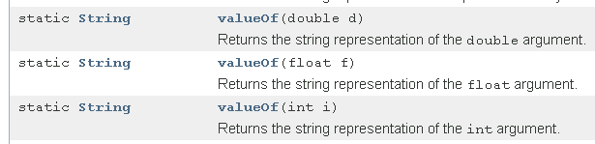
Class methods in String class
3. OOP
We have used instance methods in String class, but not class methods
Some class methods in String class:
String str = String.valueOf(123);
What does str contain after the above statement?

[CS1020 Lecture : OOP Part 1]

Slide 27


Constructors (1/2)
3. OOP
When a class (eg: String, Scanner) provides instance methods, it expects instances (objects) to be created from that class
This requires a special method called a constructor
Scanner sc = new Scanner(System.in);
Note the keyword new
String str1 = new String();
String str2 = new String("To be or not to be?");
[CS1020 Lecture : OOP Part 1]

Slide 28
Constructors (2/2)
3. OOP
The keyword new is used to invoke the constructor
Exception: String class
String str1 = new String();
String str2 = new String("To be or not to be?");
Somewhat equivalent *
* Just for today’s purpose. The 2 ways of constructing a string are not exactly equivalent though.
String str1 = "";
String str2 = "To be or not to be?";
String is a special class
Has an alternative syntax to construct a String object
String objects are immutable
More about Strings (to be explored in tutorial)
[CS1020 Lecture : OOP Part 1]

Slide 29
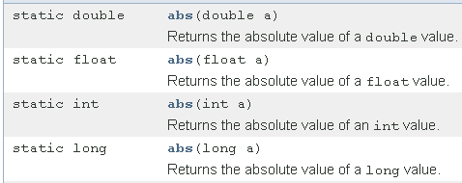

Overloading
3. OOP
Observe that some methods have identical names, but with different parameters. This is called overloading.
Math class
Overloaded methods
Without overloading, different named methods would have to be provided:
absDouble(double a)
absFloat(float a)
absInt(int a)
absLong(long a)
With overloading, all these related methods have the same name.
String class
Overloaded constructors
[CS1020 Lecture : OOP Part 1]

Slide 30
4. More Classes
Many classes in Java API!

Slide 31
DecimalFormat Class (1/3)
4. More Classes
We have used the System.out.printf() statement to format the output of real number
System.out.printf("Math.PI = %.3f\n", Math.PI);
Math.PI = 3.142
Alternatively, you may use the DecimalFormat class
Import java.text package
[CS1020 Lecture : OOP Part 1]

Slide 32
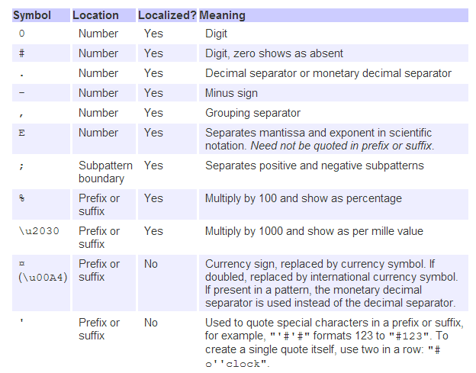
DecimalFormat Class (2/3)
4. More Classes
Example:
DecimalFormat df = new DecimalFormat("0.000");
[CS1020 Lecture : OOP Part 1]

Slide 33
DecimalFormat Class (3/3): Example
TestDecimalFormat.java
import java.text.DecimalFormat;
public class TestDecimalFormat {
public static void main(String[] args) {
DecimalFormat df1 = new DecimalFormat("0.000"); // 3 dec. pl.
DecimalFormat df2 = new DecimalFormat("#.###");
DecimalFormat df3 = new DecimalFormat("0.00%");
System.out.println("PI = " + df1.format(Math.PI));
System.out.println("12.3 formatted with \"0.000\" = "
+ df1.format(12.3));
System.out.println("12.3 formatted with \"#.###\" = "
+ df2.format(12.3));
System.out.println("12.3 formatted with \"0.00%\" = "
+ df3.format(12.3));
}
}
4. More Classes
PI = 3.142
12.3 formatted with "0.000" = 12.300
12.3 formatted with "#.###" = 12.3
12.3 formatted with "0.00%" = 1230.00%
Note that df.format(x) does not change the value x. It merely displays the value x in the specified format.
[CS1020 Lecture : OOP Part 1]

Slide 34
Random Class (1/4)
4. More Classes
Sometimes we may need to generate random numbers for some applications, such as simulation or to fill an array with random values
The Math class provides a random() method
static double | random() Returns a double value with a positive sign, greater than or equal to 0.0 and less than 1.0.
Alternatively, you may use the Random class
Import java.util package
[CS1020 Lecture : OOP Part 1]

Slide 35
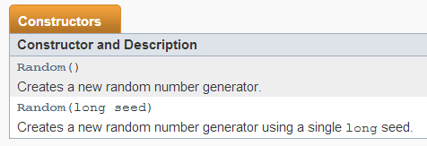
Random Class (2/4)
4. More Classes
Constructors
Random(): random numbers generated are different each time program is run
Random(long seed): random numbers generated are taken from a pre-determined fixed sequence based on the seed
[CS1020 Lecture : OOP Part 1]

Slide 36
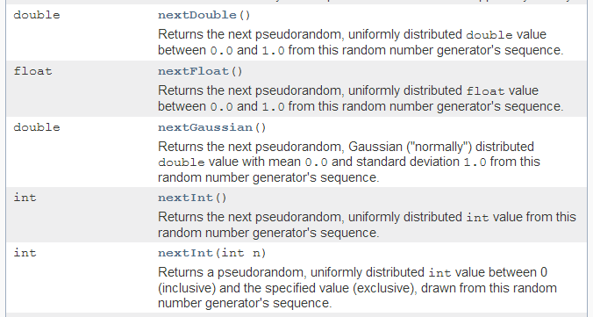
Random Class (3/4)
4. More Classes
Some methods in Random class
[CS1020 Lecture : OOP Part 1]

Slide 37
Random Class (4/4): Example
TestRandom.java
import java.util.Random;
public class TestRandom {
public static void main(String[] args) {
// To generate a random integer in [51,70]
// using Math.random() and Random's nextInt()
int num1 = (int) (Math.random() * 20) + 51;
System.out.println("num1 = " + num1);
Random rnd = new Random();
int num2 = rnd.nextInt(20) + 51;
System.out.println("num2 = " + num2);
}
}
4. More Classes
num1 = 51
num2 = 68
int | nextInt(int n) Returns a pseudorandom, uniformly distributed int value between 0 (inclusive) and the specified value (exclusive), drawn from this random number generator’s sequence.
[CS1020 Lecture : OOP Part 1]

Slide 38
Wrapper Classes (1/2)
Object-oriented counterparts of primitive data types
Types such as int, float, double, char, boolean, etc. are primitive data types.
They are not objects. They are legacies of older languages.
Sometimes we need object equivalent of these primitive data types (when we cover more advanced OOP concepts later)
4. More Classes
Primitive data type | Wrapper class
int | Integer
long | Long
float | Float
double | Double
char | Character
boolean | Boolean
and others…
These are called wrapper classes – one wrapper class corresponding to each primitive data type
[CS1020 Lecture : OOP Part 1]

Slide 39
Wrapper Classes (2/2)
We may convert a primitive type value to its corresponding object. Example: between int and Integer:
int x = 9; Integer y = new Integer(x); System.out.println("Value in y = " + y.intValue());
Wrapper classes offer methods to perform conversion between types
Example: conversion between string and integer:
int num = Integer.valueOf("28");
num contains 28 after the above statement
String str = Integer.toString(567);
str contains “567” after the above statement
Look up the API documentation and explore the wrapper classes on your own
4. More Classes
[CS1020 Lecture : OOP Part 1]

Slide 40
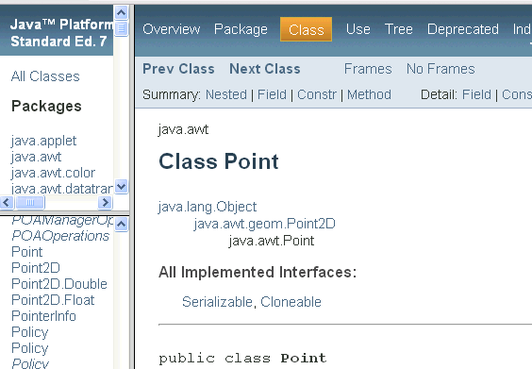
Point Class (1/5)
An OOP program allows the creation of instances (also called objects) of a class and passing messages to these objects (calling methods on these objects)
We have used Scanner and String classes
4. More Classes
We introduce another class, Point, which contains a number of OOP concepts we will explore in more depth in next lecture
Import java.awt package
[CS1020 Lecture : OOP Part 1]

Slide 41
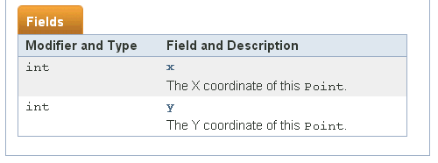
Point Class (2/5): Attributes
The Point class contains 2 attributes
Sometimes also called data members
In the API documention, they are labelled as fields
Attributes can be class attributes (with static modifier) or instance attributes (without static modifier)
Details to be covered in next lecture
The 2 attributes in Point class are instance attributes: x and y, representing the x- and y-coordinates
4. More Classes
[CS1020 Lecture : OOP Part 1]

Slide 42
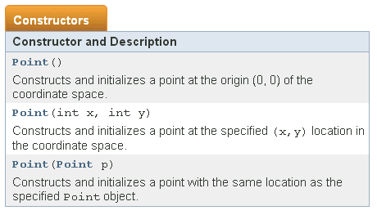
Point Class (3/5): Constructors
These are the overloaded constructors in Point class
4. More Classes
pt1
0
0
pt2
9
6
Examples:
Point pt1 = new Point(); // pt1 is (0, 0)
Point pt2 = new Point(9, 6); // pt2 is (9, 6)
[CS1020 Lecture : OOP Part 1]

Slide 43
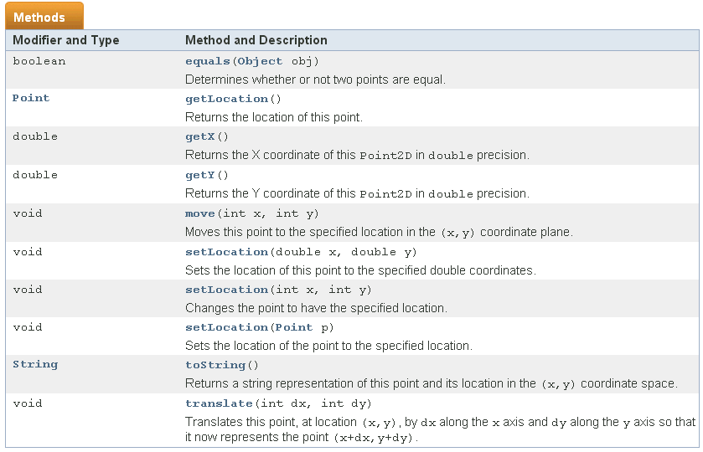
Point Class (4/5): Methods
Methods in Point class
4. More Classes
[CS1020 Lecture : OOP Part 1]

Slide 44
Point Class (5/5): Demo
TestPoint.java
// To test out Point class
import java.util.*;
import java.awt.*;
public class TestPoint {
public static void main(String[] args) {
Scanner sc = new Scanner(System.in);
System.out.print("Enter x and y: ");
int xCoord = sc.nextInt();
int yCoord = sc.nextInt();
Point pt = new Point(xCoord, yCoord);
System.out.println("x-coordinate is " + pt.getX());
System.out.println("y-coordinate is " + pt.y);
System.out.println("The point created is " + pt);
// or: System.out.println("The ... is " + pt.toString());
}
}
4. More Classes
Enter x and y: 12 -7
x-coordinate is 12.0
y-coordinate is -7
The point created is java.awt.Point[x=12,y=-7]
Note: getX() returns double
To be discussed in next lecture.
[CS1020 Lecture : OOP Part 1]

Slide 45
Common Mistake
Accessing an object before it is created
4. More Classes
Point pt;
pt.setLocation(12,10); // change coordinates of pt
pt
The Point object does not even exist!
Point pt = new Point(); // create Point object pt
pt.setLocation(12,10); // change coordinates of pt
pt
0
0
12
10
[CS1020 Lecture : OOP Part 1]

Slide 46
Practice Exercises
Practice Exercise | Class
#7: Reading Techniques | String
#8: Vaccination | Scanner
#9: Vaccination Version 2 | Scanner
#10: One-Line Pretty Printer | String
#11: Area of Circle Enclosing a Square | Math
#12: Triangle Centroid | Point and Point2D.Double
4. More Classes
Mounted on CodeCrunch and also listed on the CS1020 website → “Practice Exercises” page
http://www.comp.nus.edu.sg/~cs1020/4_misc/practice.html
Attempt these exercises and discuss them on the IVLE forum
[CS1020 Lecture : OOP Part 1]

Slide 47

FAQ
Q: Must we know all the classes on the API?
4. More Classes
A: There are hundreds of them, so you cannot possibly know all of them. ☺ You are expected to know those covered in lectures, labs, tutorials and any additional materials given out, which include discussion on the IVLE forums.
Familiarity is the key, so you need to practise a lot, and refer to the API document as often as possible. There are many things not covered in class but you can explore on your own.
Like CS1010 (or equivalent), you must be prepared to invest time in CS1020.
[CS1020 Lecture : OOP Part 1]

Slide 48
5. Abstraction and Information Hiding
Principles of Programming and Software Engineering

Slide 49
What is Abstraction?
In subsequent weeks, we will learn more about OOP design issues
One issue is abstraction
Procedural abstraction: Specify what to do, not how to do it → separates the purpose of a method from its implementation
Data abstraction: Specify what you will do to data, not how to do it → focuses on what operations on the data are to be provided instead of their implementation. More on this when we cover ADT.
In both cases, we apply information hiding
Ref: Textbook pg 120 – 122
5. Abstraction
[CS1020 Lecture : OOP Part 1]

Slide 50

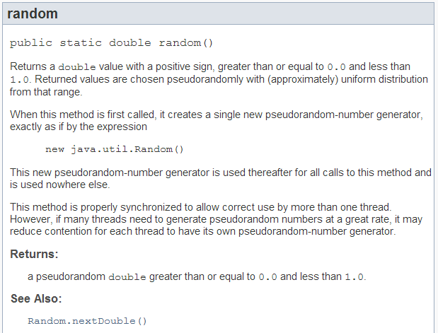
Procedural Abstraction
Math class
5. Abstraction
The API documentation describes what random() does
What parameters (if any) it takes
What result it returns (if any)
This provides an interface with the user.
How the method is implemented is hidden from the user.
When you write your own methods, you should provide a description of each method like this.
[CS1020 Lecture : OOP Part 1]

Slide 51
Summary
We revisit a few classes (Scanner, String, Math) and learn a few new ones (DecimalFormat, Random, wrapper classes, Point)
We discuss some basic OOP features/concepts such as modifiers, class and instance methods, constructors and overloading.
Today, we focus on using classes provided by API as a user.
Next week, you will become designers to create your own classes!
[CS1020 Lecture : OOP Part 1]

Slide 52
Advice
Important that you explore on your own after lecture!
OOP involves many concepts, too many to be covered in one or two lectures.
Hence, you cannot expect to learn everything in just one sitting. You probably need to re-visit the topics/concepts over and over again.
Additional materials may be introduced in tutorials/labs.
Attempt the practice exercises and the IVLE self-assessments. They are not graded.
Many of the practice exercises are simple exercises to test your understanding of the very basic – must do them!
Please post your queries on the IVLE forum. Try not to email us, unless your queries are of private nature.
[CS1020 Lecture : OOP Part 1]

Slide 53
Misc.: Dr Java (1/3)
http://drjava.sourceforge.net/
DrJava is a simple IDE you may use for practice on Java programming.
This is only for your own use. For sit-in labs, you will be given a special UNIX account and you must work in the UNIX environment, using the vim editor. (Non-CS1010/CS1010J students please take note.)
[CS1020 Lecture : OOP Part 1]

Slide 54
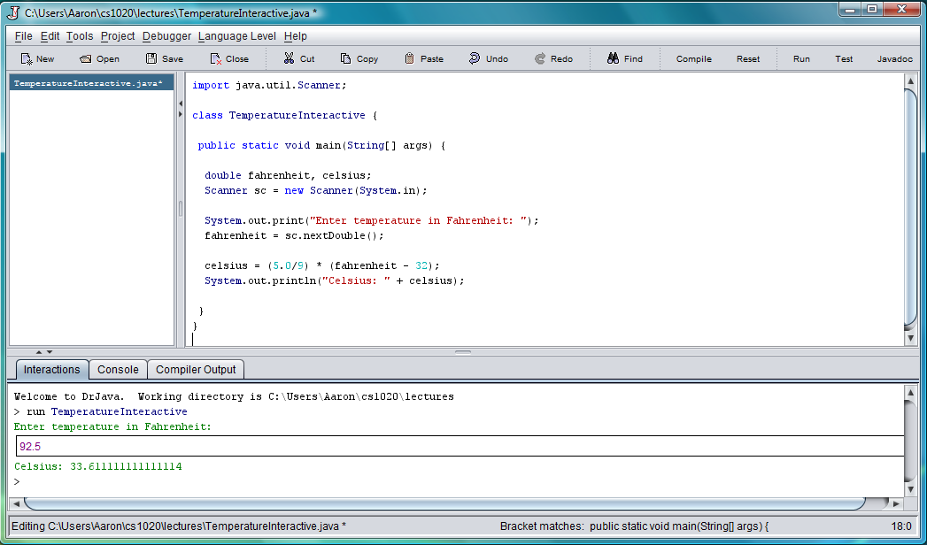
Misc.: Dr Java (2/3)
Running Week 1’s TemperatureInteractive.java
[CS1020 Lecture : OOP Part 1]

Slide 55
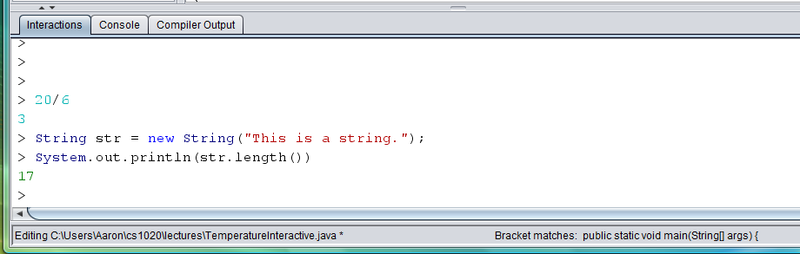
Misc.: Dr Java (3/3)
You may also type statements directly in the “Interactions” pane
Good for quick checks
[CS1020 Lecture : OOP Part 1]

Slide 56
End of file

